Slide 1
Springboard - Data Science Career Track
Capstone Project 2
Predicting Water Availability
By Ellen Savoye - June 22, 2021

Slide 2
Table Of Contents
Introduction
Data / Data Munging
Exploratoring Stationarity & Seasonality
Decomposition/Differencing
Models - ARIMA, Auto-ARIMA, Prophet
Wrap-Up
Recommendations for the Client
Future Work

Slide 3

Introduction
Water is an important part of everyday life. It’s easy to take the seemingly endless supply for granted. However, the water supply isn’t endless. To sustain our usage, water supply companies need to be able to forecast the amount of water in a given body of water under their purview to handle user consumption. These bodies of water could be a water spring, a lake, a river, or an aquifer. Each is affected by the changing of the seasons. Typically, bodies of water are replenished in the cooler seasons (autumn, winter) while warmer months (spring, summer) have a decrease in water level. Regardless of the season, it is important to be able to predict water availability, in terms of level or flow. Can a model be developed to predict water availability?

Slide 4
Data & Data Munging
Kaggle competition sponsored by Acea group
Cleaning the data
1
3
2
Water source datasets - independent
4
Removing data prior to 2016

Slide 5
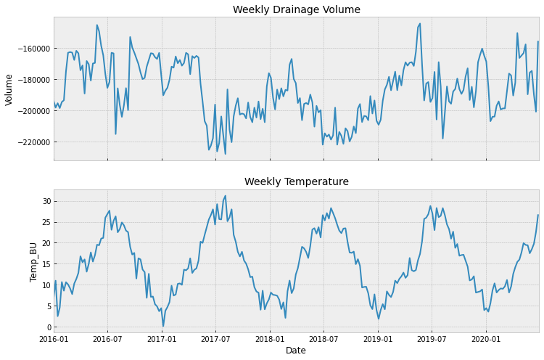
Exploratoring Stationarity & Seasonality
Is the data stationary?
1
2
ADF Results

Slide 6
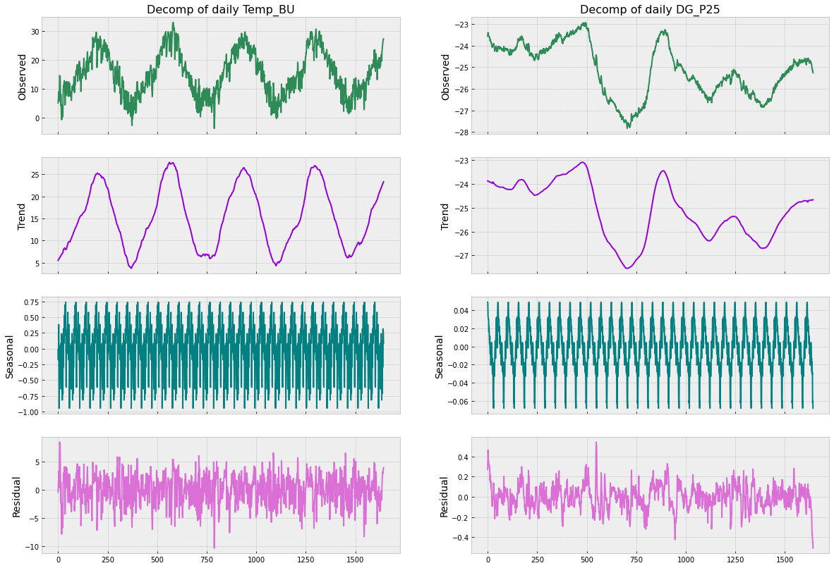
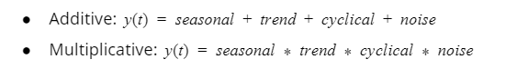
Decomposition

Slide 7
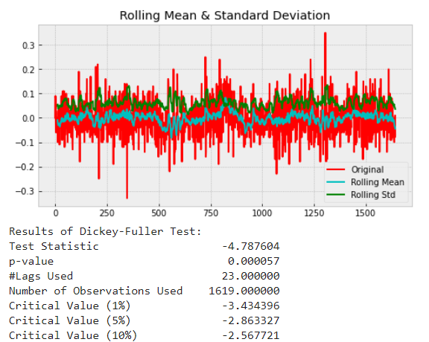
Differencing
Order of 1 (day)
1

Slide 8
Models

Slide 9
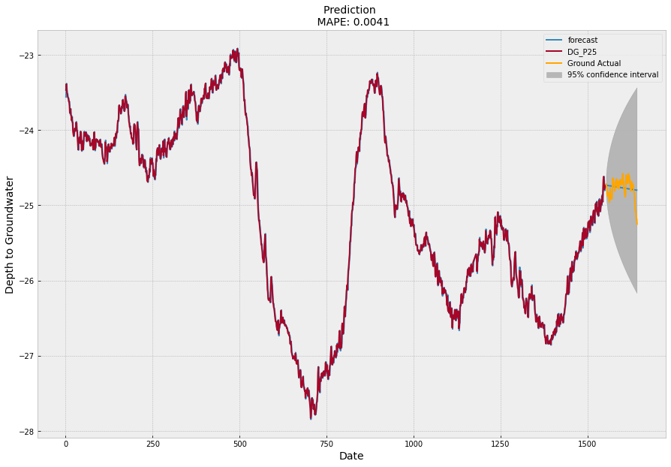
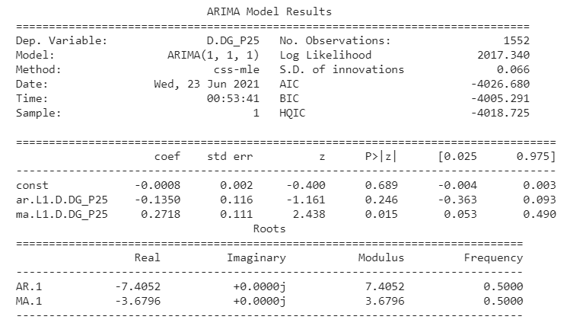
Baseline - ARIMA

Slide 10
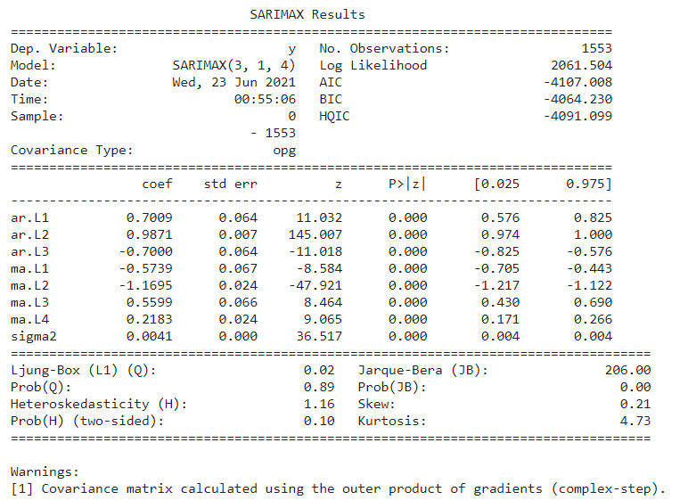
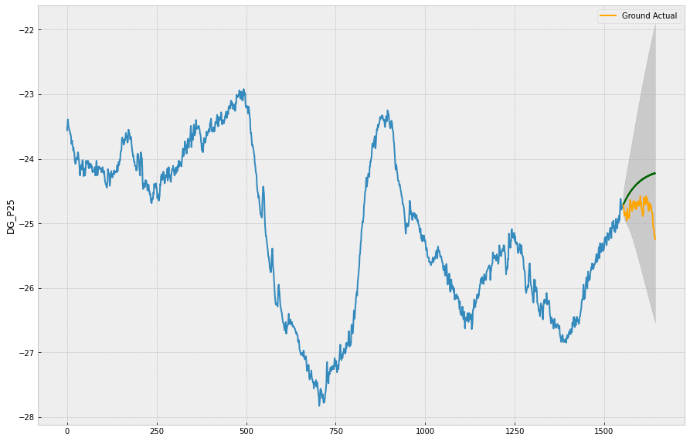
2nd Model- Auto-ARIMA

Slide 11
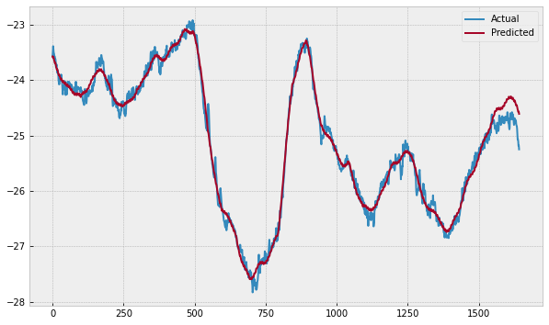
3rd Model - Prophet

Slide 12
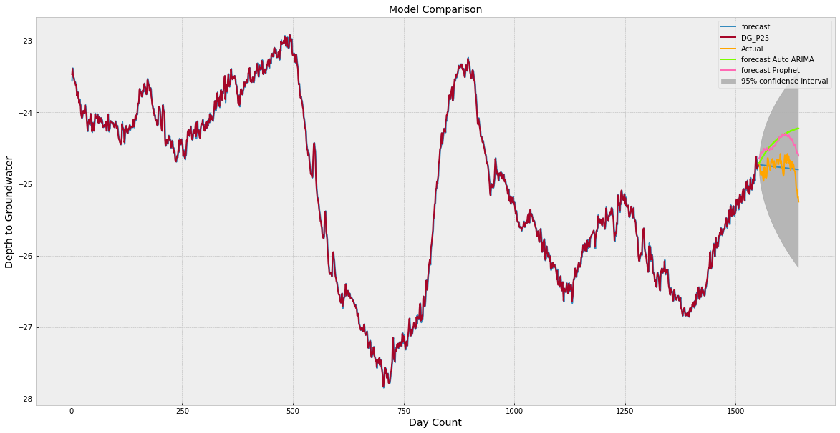
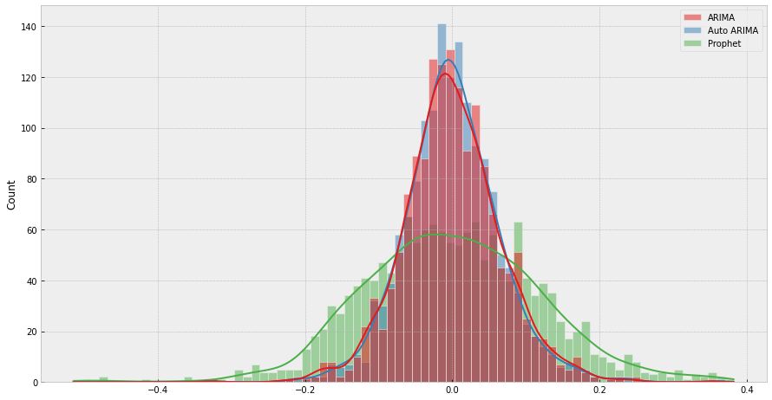
Comparing all 3

Slide 13
Wrap-Up - Model Selection
Model | RMSE | MAE | MAPE | Lower/Upper Bound (meters)
ARIMA | 0.133285 | 0.101149 | 0.004071 | -0.04047/0.03853
Auto-ARIMA | 0.429095 | 0.383468 | 0.015447 | -0.039098/0.037956
Prophet | 0.141993 | 0.107153 | 0.004275 | -0.26365/0.29985

Slide 14
Recommendations for the Client

Slide 15
Future Work
Multivariate ARIMA
1
2
Additional Model: Univariate LSTM

Slide 16
Thank you.

